Slide 1
A red bead. Which bag?
Flip a fair coin to choose a bag, then draw one bead.
Bag A
Bag B
The bead is red.
R
R
R
B
R
R
B
B
B
Which bag is
more likely?
3 red, 1 blue
1 red, 3 blue
3 of the 4 possible red draws come from Bag A.
Updated chance: Bag A 75%, Bag B 25%.
01

Slide 2
Bayes’ rule puts the count into a formula
Before seeing red: 50% for A. After seeing red: 75%.
posterior
likelihood
prior
updated belief
fit with the evidence
starting belief
P(E | H)
×
P(H)
P(H | E)
=
P(E)
overall chance of the evidence
For Bag A: (¾ × ½) ÷ ½ = ¾ = 75%
H = “the bead came from A” E = “the bead is red”
Does explaining self-experience explain the self?
02

Slide 3
Predictive processing: predict and correct
Current expectations
A predicts red more often than B does.
mismatch helps
revise expectations
predict the input
R
Sensory input: a red bead
The new guess favors A. B remains possible.
Conceptual loop / An exact Bayesian answer also depends on the prior and uncertainty in the predictions.
Does explaining self-experience explain the self?
03

Slide 4
Two ways to represent uncertainty
Population coding
Sampling
A pattern across neurons
Candidate guesses over time
A: 75%
B: 25%
A
A
B
A
A
B
A
A
One pattern represents the probabilities.
Read each row left to right.
A occurs about 3 times as often as B.
Illustrations, not neural measurements / The short sample sequence shows the idea; real sequences vary.
Does explaining self-experience explain the self?
04

Slide 5
The Bayesian answer and the brain’s method
Same evidence. Same updated chance: 75% for A.
Predictive coding
Population coding
Sampling
predict
A A B A
correct
Signals revise expectations.
A pattern encodes uncertainty.
Frequencies encode uncertainty.
What evidence would show how the brain does it?
These proposals can work together. A Bayesian answer alone does not choose among neural mechanisms.
Does explaining self-experience explain the self?
05

Slide 6
Puzzle 1: Authorship
1.
My sense of self results from constructive processes in my brain.
2.
I do not choose or directly control many of those processes.
3.
An identity produced through processes I neither choose nor control cannot genuinely be my own.
4.
My identity genuinely is my own.
Puzzle 1: Must I invent myself to be myself?
06

Slide 7
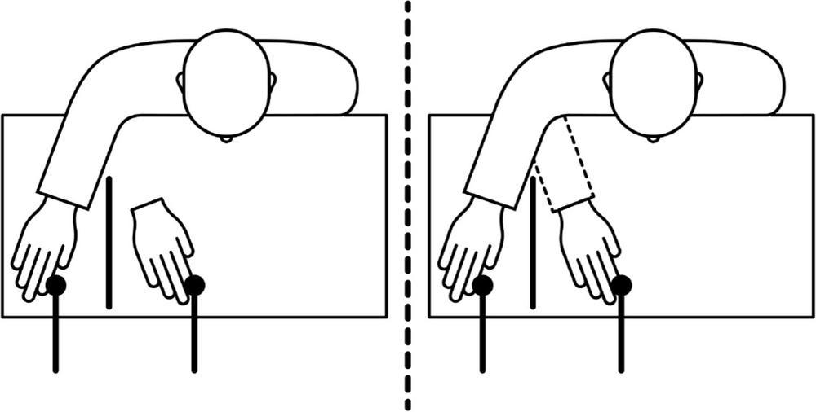
When a hand feels like yours
Alana asks: If the rubber-hand illusion does not work for everyone, how strong is the evidence?
Seth, chapter 8, figure 17
Puzzle 1: Must I invent myself to be myself?
07

Slide 8
How ownership can shift
Vision
Touch
Proprioception
Where touch is seen
Where contact is felt
Where the hand is
A common bodily source?
Seth’s account: the brain infers which body is mine.
Seth, chapter 8
Puzzle 1: Must I invent myself to be myself?
08

Slide 9
The parts of self-experience
Bodily ownership
This body feels like mine.
Perspective
I experience the world from here.
Agency
I experience myself as acting.
Narrative identity
I have a remembered past and a future.
Social identity
I experience how others see me.
Sarah asks: Can we control how much others’ perceptions shape our sense of self?
Seth, chapter 8
Puzzle 1: Must I invent myself to be myself?
09

Slide 10
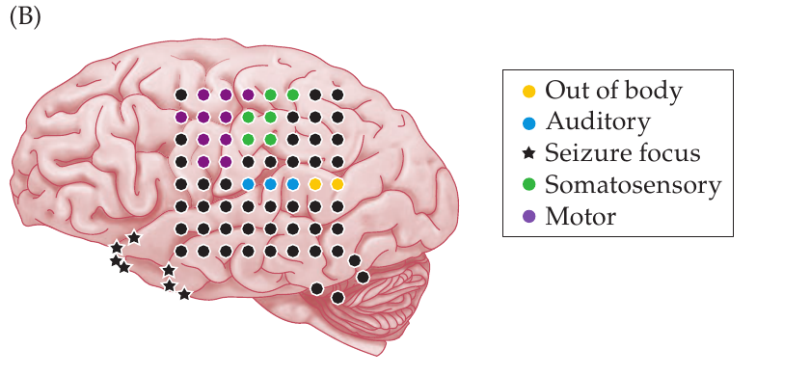
Where am I?
Temporoparietal junction
Integrates information
about the body in space
Stimulation changed
reported self-location.
PCN, figure 11.2B / Clinical stimulation evidence; see Blanke et al. (2002)
Puzzle 1: Must I invent myself to be myself?
10

Slide 11
What does the evidence support?
Ownership and perspective can change.
These experiences depend on processes we do not
deliberately choose.
Does that make an identity less genuinely mine?
Puzzle 1: Must I invent myself to be myself?
11

Slide 12
Puzzle 1 revisited
1.
My sense of self results from constructive processes in my brain.
2.
I do not choose or directly control many of those processes.
3.
An identity produced through processes I do not choose or control cannot genuinely be my own.
4.
My identity genuinely is my own.
Emily asks: If brain processes shape our identity, how much control do we have over who we become?
Puzzle 1: Must I invent myself to be myself?
12

Slide 13
The reality of a constructed self
Unchosen construction can still feel genuinely mine.
Does that establish a real subject,
or an experience of one?
Mackenzie asks: Does the brain create our sense of self, or does the self exist independently?
From authorship to the reality of a subject
13

Slide 14
Puzzle 2: Reality and value
1.
My self is constructed by my brain.
2.
A constructed self is a fiction, rather than a real subject of experience.
3.
Something can be genuinely good or bad for me only if there is a real subject for whom it is good or bad.
4.
Some things are genuinely good or bad for me: my suffering and happiness really matter.
Puzzle 2: What must be real for my life to matter?
14

Slide 15
Feeling the body from within
Interoception
Sensing the body’s internal
physiological condition
Bodily signals can guide regulation
without becoming conscious feelings.
Seth, chapter 9 / PCN, pp. 364–365 / Neuroscience, p. 478
Puzzle 2: What must be real for my life to matter?
15

Slide 16
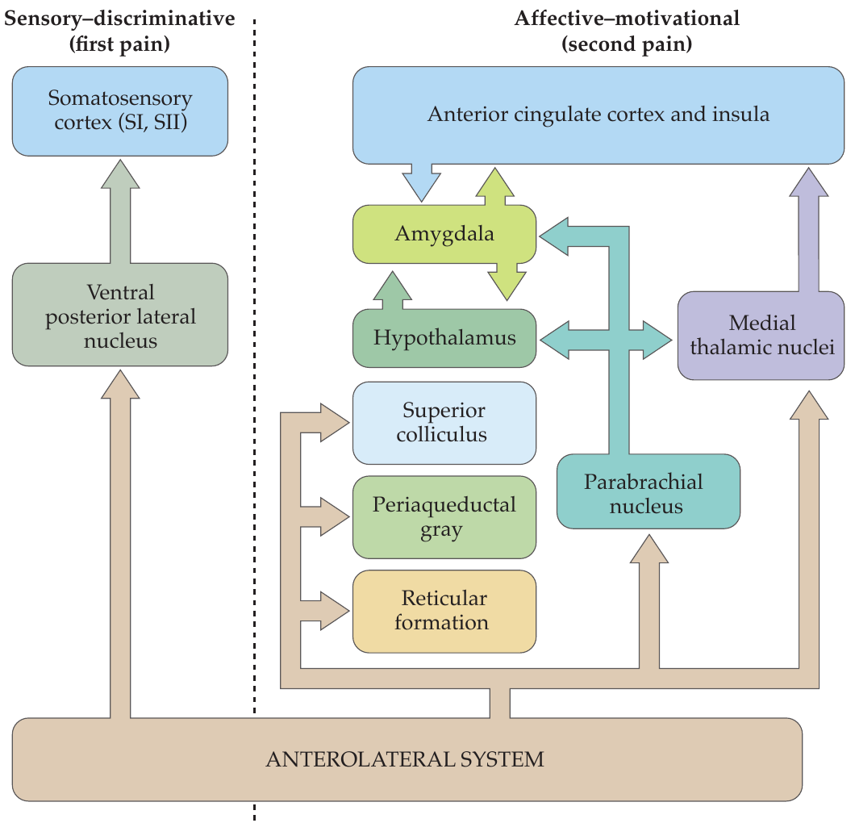
The body’s regulation network
Brainstem
Relays and autonomic responses
Hypothalamus
Coordination of bodily regulation
Insula and cingulate
Bodily representation and feeling
Michael asks: How far can mouse studies and rare disorders explain weight regulation in most people?
Selected pain pathways / Neuroscience, figure 21.7
Puzzle 2: What must be real for my life to matter?
16

Slide 17
Prediction and bodily regulation
Update the estimate
Act on the body
It is colder than expected.
Put on a coat.
Generate heat by shivering.
Seth’s active inference: predictions can guide regulation.
Seth, chapter 9, on active inference
Puzzle 2: What must be real for my life to matter?
17

Slide 18
Stability through change
Allostasis
Adjusting bodily activity
to meet changing demands
Standing up changes the demands on circulation.
The body adjusts to maintain function.
Seth, chapter 9
Puzzle 2: What must be real for my life to matter?
18

Slide 19
Seth’s beast-machine proposal
The feeling of being a self
is rooted in predictive control
of a living body.
A proposal about what bodily experience consists in
/ Chapter 9
Puzzle 2: What must be real for my life to matter?
19

Slide 20
Why do we feel stable?
Keeping the body viable
Strong expectations can help organize stable regulation.
Feeling like a continuing self
Seth proposes that regulatory predictions shape this feeling.
Alana asks: Why would a change in how my body feels mean a change in who I am?
Puzzle 2: What must be real for my life to matter?
20

Slide 21
Puzzle 2 revisited
1.
My self is constructed by my brain.
2.
A constructed self is a fiction, rather than a real subject of experience.
3.
Something can be genuinely good or bad for me only if there is a real subject for whom it is good or bad.
4.
Some things are genuinely good or bad for me: my suffering and happiness really matter.
Puzzle 2: What must be real for my life to matter?
21

Slide 22
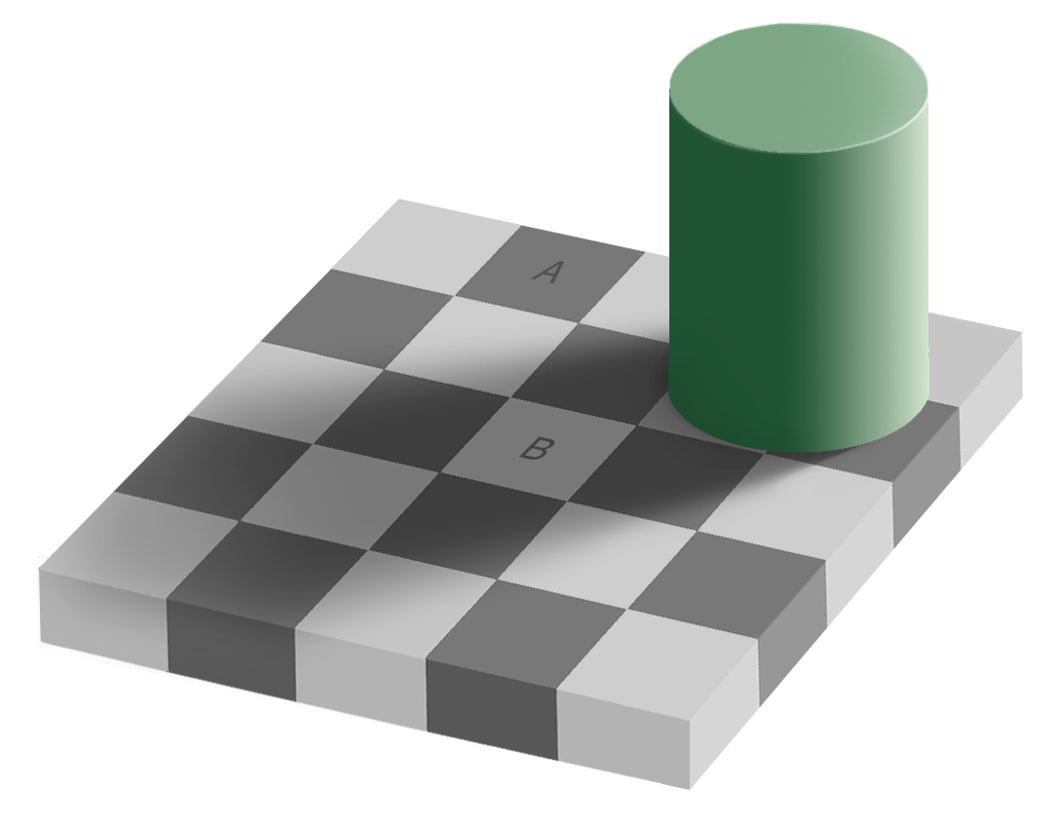
Construction and reality
A constructed experience
can concern something real.
Does the same hold
for the self?
Adelson checker-shadow illusion / Recall Friday’s construction-and-constraint argument
Puzzle 2: What must be real for my life to matter?
22

Slide 23
A life without a continuous story
Clive Wearing
Severely disrupted
autobiographical continuity
Continuing bodily experience,
affection and musical ability
What would have to disappear before
this person’s suffering stopped mattering?
Case discussed in Seth, chapter 8
Puzzle 2: What must be real for my life to matter?
23

Slide 24
Experience and moral importance
1.
Where there is genuine suffering, there is
a moral reason for concern.
2.
Genuine suffering need not require
a continuous autobiography.
A continuous autobiography is not required
for moral concern.
Which claim needs an ethical argument? Which needs evidence?
Puzzle 2: What must be real for my life to matter?
24

Slide 25
Two puzzles to take away
Must I invent myself to be myself?
What must be real for my life to matter?
Next: animal consciousness and morally significant experience
25

