Slide 1
Perception as
controlled hallucination
How can perception put us in touch with the world if the brain constructs what we see?
Neuroethics / Friday, October 16, 2026
01

Slide 2
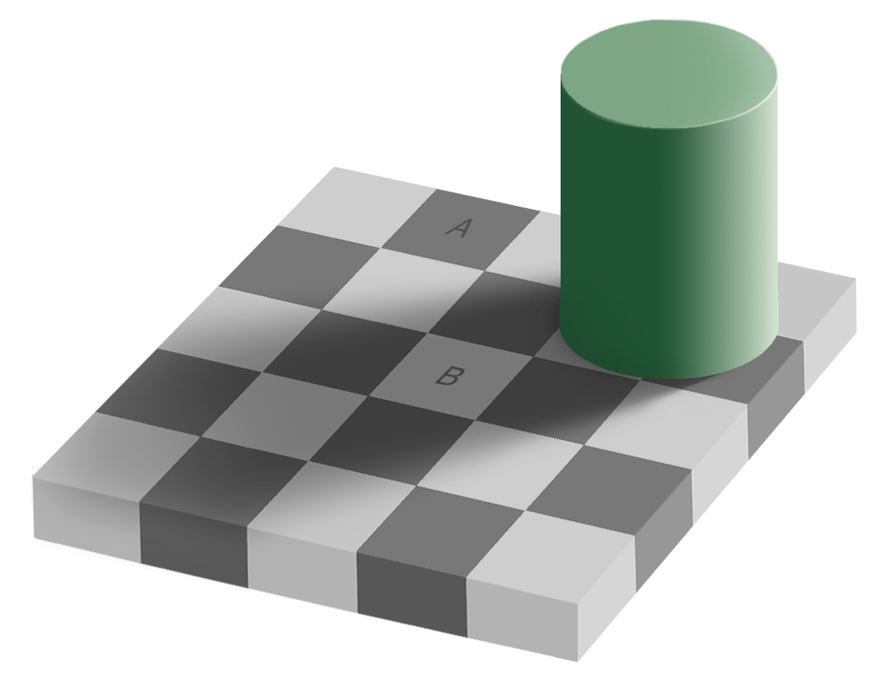
Which square looks lighter?
Edward H. Adelson, checker-shadow illusion
How can a constructed perception put us in touch with the world?
02

Slide 3
The patches on their own
A
B
Matching pixel values
RGB (120, 120, 120)
Do they still look different
in the scene?
Adelson • Samples cropped without changing their color
How can a constructed perception put us in touch with the world?
03

Slide 4
One signal, several possible sources
The same amount of light
A light surface
in shadow
A darker surface
under stronger light
The signal alone cannot tell us which.
How can a constructed perception put us in touch with the world?
04

Slide 5
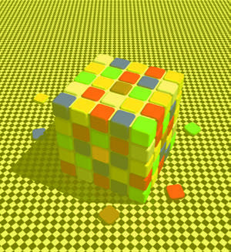
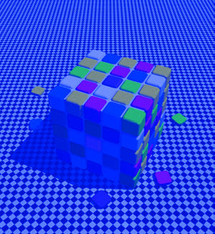
Color constancy
1
1
Compare the tiles marked 1.
PCN, figure 3.17 (constancy comparison) / Purves and Lotto (2011)
How can a constructed perception put us in touch with the world?
05

Slide 6
Perception as a best guess
What most likely produced
these sensory signals?
An automatic estimate under uncertainty
How can a constructed perception put us in touch with the world?
06

Slide 7
What the brain already expects
Prior
An expectation brought
to new information
Shadows dim the light.
The surface can stay the same.
Seth, chapters 4–5 • Checkerboard: Edward H. Adelson
How can a constructed perception put us in touch with the world?
07

Slide 8
Predictions and prediction errors
Prediction
Prediction error
The sensory signals implied
by an interpretation
A mismatch with
incoming signals
The mismatch can help update the interpretation.
How can a constructed perception put us in touch with the world?
08

Slide 9
How much should evidence matter?
Through fog
A clear, close view
Uncertain evidence
More reliable evidence
More reliable sensory evidence
can outweigh existing expectations.
How can a constructed perception put us in touch with the world?
09

Slide 10
The checkerboard explained
B appears
in shadow.
The context changes
its apparent lightness.
Seth, chapter 4 • Checkerboard: Edward H. Adelson
How can a constructed perception put us in touch with the world?
10

Slide 11
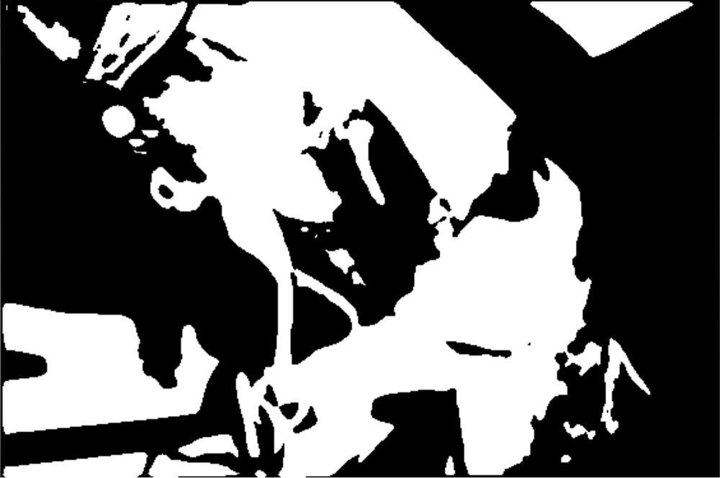
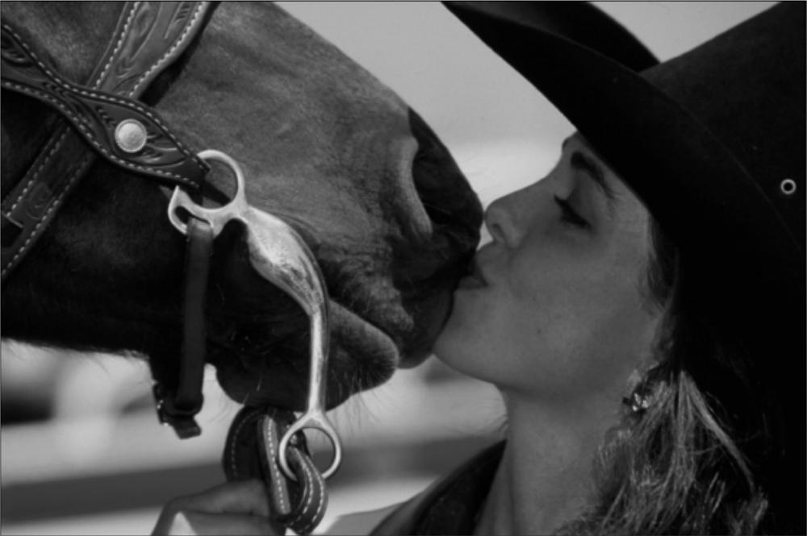
What can you see?
The image is unchanged.
Teufel, Dakin & Fletcher (2018), CC BY 4.0 • As reproduced in Seth, figures 6–7
How can a constructed perception put us in touch with the world?
11

Slide 12
Seth’s stronger claim
Perceptual experience is the content
of the brain’s best guesses about
the causes of its sensory signals.
Seth’s further claim about experience
How can a constructed perception put us in touch with the world?
12

Slide 13
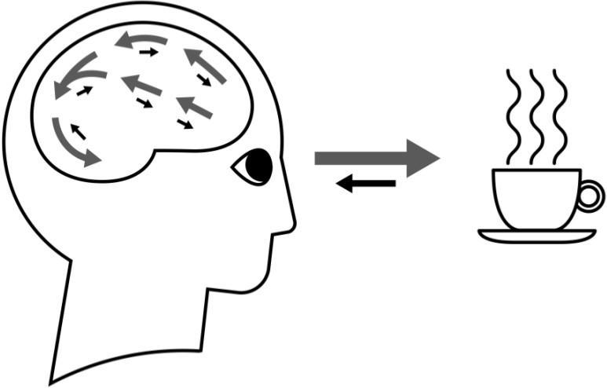
What makes it controlled?
Sensory evidence
constrains the guesses.
A closer look supplies
new evidence.
Gray arrows: predictions
Black arrows: prediction errors
Seth, Being You, figure 4
How can a constructed perception put us in touch with the world?
13

Slide 14
What have the examples established?
Context and prior experience
help shape what we see.
Do these examples establish
Seth’s particular explanation?
How can a constructed perception put us in touch with the world?
14

Slide 15
Is “hallucination” the right word?
Does “controlled hallucination”
clarify how we see?
What does it help us notice?
What might it lead us to misunderstand?
How can a constructed perception put us in touch with the world?
15

Slide 16
Construction and contact with the world
How can perception put us in touch with the world if the brain constructs what we see?
The world can constrain the interpretation we construct.
Exit: Using the checkerboard, how can seeing be
a best guess and still answer to the world?
16

