Slide 1
Finally, onto philosophy…
WORKPLACE ENHANCEMENT
Alex uses a drug to stay alert during long workdays.
Jordan prefers not to use it.
Their manager makes Alex’s longer hours
the standard for both employees.
What facts do we need, and what would make
this arrangement fair or unfair?
PHL / NEU 251 Session 5 Farah and May
1

Slide 2
Farah’s expanding field
Basic inquiry | Understanding thought and behavior
Medical application | Diagnosing or treating a condition
Nonmedical application | Education, employment, marketing, security
Our workplace case is a nonmedical application.
Farah, pp. 761–764, 768–772
2

Slide 3
Neuroliteracy
What would justify each inference?
iPhone neuromarketing (2011)
Insula activity means users love their phones.
Insula activity occurs in many tasks.
How specific is this evidence?
Oxytocin research (2005–2020)
A “trust hormone” should reliably increase trust.
Pharmacological interventions do not reliably produce behavioral effects
Psychiatric SPECT scans (2012 debate)
A brain image should settle the diagnosis.
What does the scan add
to an interview?
Farah, pp. 773–774 Connections to Sessions 2–4
3

Slide 4
Mind, brain, and physicalism
A brain intervention changes someone’s experience.
PHYSICALISM
INTERACTIONIST DUALISM
Mental phenomena are
physical phenomena.
Mind and body are distinct
and causally interact.
Could both views accommodate this finding?
Causal dependence and identity require different arguments.
May, pp. 15–17
4

Slide 5
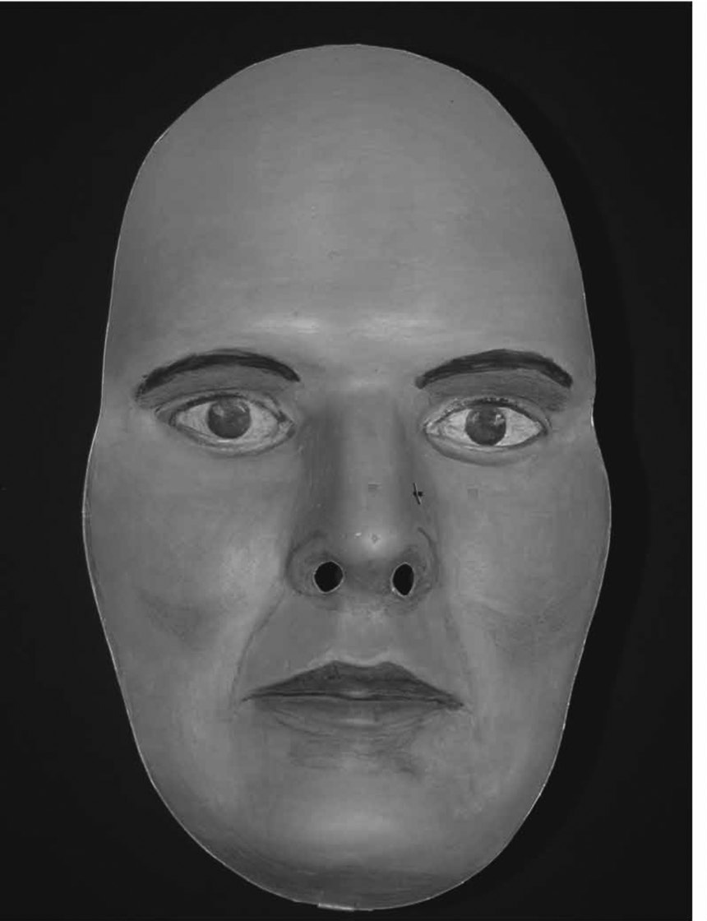
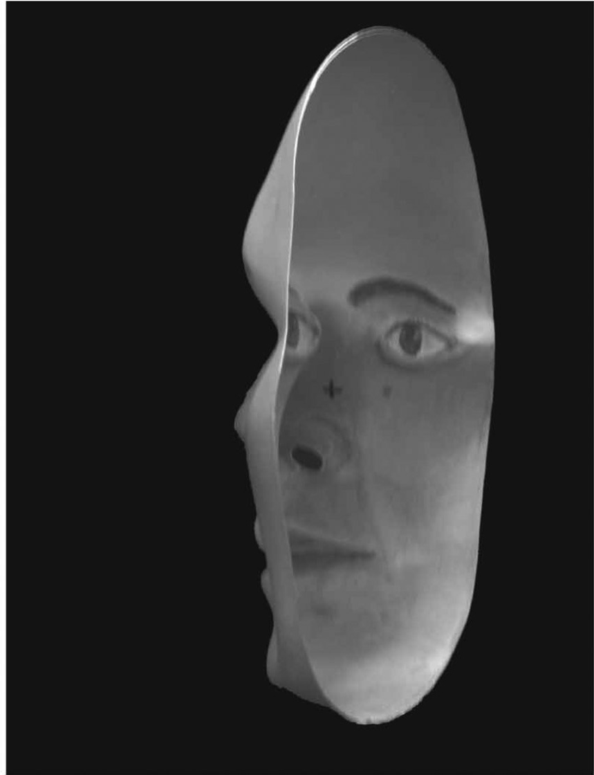
Perception and evidence
The mask looks convex.
The mask is concave.
Can both claims be true?
EPISTEMOLOGY
Knowledge and justification
Appears convex
Actually concave
May, p. 18, Fig. A.1 Papathomas and Bono (2004)
5

Slide 6
Questions in ethics
Does the drug improve performance?
May the manager expect employees to take it?
What generally makes an action right?
Can moral judgments be objectively true?
Empirical inquiry
Applied ethics
Normative
ethical theory
Metaethics
“Employees believe the arrangement is unfair.” What kind of claim is that?
May, pp. 20–22
6

Slide 7
An ethical argument
EMPIRICAL PREMISE (SUPPOSE THIS IS TRUE)
The drug improves performance in these conditions.
PROPOSED NORMATIVE PREMISE
Employers may expect employees to use any intervention
that improves performance.
CONCLUSION
The employer may expect employees to use the drug.
What premise would connect these claims?
Instructor exercise applying May, pp. 20–22
7

Slide 8
Consequences and well-being
CONSEQUENTIALISM
An action’s moral rightness depends only on its consequences.
UTILITARIANISM
The right action maximizes overall well-being.
Whose benefits and burdens should count?
May, pp. 20–21
8

Slide 9
Duties, rights, and respect
DEONTOLOGY
Duties and constraints can limit how we pursue good outcomes.
Would a net benefit justify making drug use
a condition of keeping the job?
For discussion, assume the drug is effective and medically safe.
May, p. 21
9

Slide 10
Character and practical wisdom
VIRTUE ETHICS
Character and practical wisdom are central to living and acting well.
What would fairness, honesty, or compassion
require of this manager?
Name one concrete action and explain the virtue it expresses.
May, p. 21
10

Slide 11
Values in conflict
Autonomy
Informed choice with adequate freedom
Beneficence
Promoting people’s well-being
Non-maleficence
Avoiding or minimizing harm
Justice
Fair treatment and distribution of benefits and burdens
Which values conflict in the workplace case?
May, pp. 21–22
11

Slide 12
Workplace enhancement revisited
Alex uses a drug to work longer. Jordan prefers not to.
Their manager expects both to meet Alex’s hours.
EVIDENCE
What do we need to know?
CONCEPT
What would meaningful freedom to refuse involve?
NORM
Which principle supports your judgment?
STAKES
Who benefits, who bears the burdens, and who decides?
In pairs: give a judgment, its premises, and one reason to revise it.
Farah, p. 773 May, pp. 21–22
12

Slide 13
Ownership and control
Who decides which technologies to develop?
Who pays to test them,
and who can inspect the evidence?
Who gets access or faces pressure to use them?
Farah, pp. 774–775
13

Slide 14
Physical explanation and moral value
Suppose we fully explained a person’s behavior in physical terms.
What would follow?
RESPONSIBILITY
MORAL STANDING
When is the person
answerable or blameworthy?
Why does the person’s welfare
matter for their own sake?
Would reduced responsibility make someone’s welfare matter less?
Farah, pp. 775–776 May, pp. 15–17
14

