Slide 1
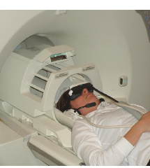
PHL / NEU 251 · SESSION 4
The instruments:
measuring minds
recorded signal
METHOD
ANALYSIS
WARRANT
1

Slide 2
Neural events become evidence through a chain of choices
1
2
3
4
5
EVENT OR INTERVENTION
SIGNAL OR OUTCOME
RECORDED DATA
ANALYZED RESULT
CLAIM
Neural activity changes, or a researcher changes the system.
A physical signal or behavioral outcome becomes observable.
The instrument samples, filters, and stores measurements.
A contrast, model, or classifier summarizes the data.
The result is interpreted as evidence about mind or behavior.
Each step introduces assumptions.
METHOD
ANALYSIS
WARRANT
2

Slide 3
We’ll deal with four kinds of evidence
OBSERVE OR RECORD
Existing lesions, structural MRI, DTI, single-unit recording, EEG, MEG, ECoG, PET, fMRI
INTERVENE
Directed lesions, TMS, tDCS, implanted stimulation, drugs, optogenetics
DESIGN AND ANALYZE
Task contrasts, dissociations, controlled trials, MVPA, connectivity, computational models, evidence synthesis
MEASURE OUTCOMES
Choices, accuracy, reaction time, symptoms, adverse events, surveys, interviews
METHOD
ANALYSIS
WARRANT
3

Slide 4
Three questions for every empirical study
METHOD
ANALYSIS
WARRANT
What produced the data?
How did the study turn the data into a result?
What conclusion does the result support?
Warrant pertains to the kind of inference made and the strength of evidence in support of it
METHOD
ANALYSIS
WARRANT
4

Slide 5
No method dominates every comparison
Method | Signal or intervention | Coverage | Timing | Causal leverage | Main limitation
Single-unit | Spikes from selected neurons | Very narrow | Milliseconds | Observational | Invasive; selective sampling
EEG / MEG | Population electrical / magnetic signal | Broad | Milliseconds | Observational | Source localization is model-dependent
PET activation | Tracer distribution | Whole brain | About a minute | Observational | Radioactivity; poor timing
BOLD fMRI | Neurovascular signal | Whole brain | Seconds | Observational | Indirect; temporally blurred
Lesion comparison | Existing neural damage | Variable | No event timing | Causal contribution | Extent, recovery, network disruption
TMS | Induced cortical activity change | Limited targets | Protocol varies | Causal contribution | Spread; limited depth
METHOD
ANALYSIS
WARRANT
5

Slide 6
Electrical recording
MEG sensors
SINGLE-UNIT
Spikes from selected neurons
scalp EEG
EEG
ECoG
Scalp voltage reflecting summed postsynaptic currents in synchronized populations
single-unit
ERP
An event-locked response estimated from EEG across repeated trials
MEG
Magnetic fields generated by neural current flow
ECOG
Electrical activity recorded from the cortical surface
event
event-locked average (illustrative)
METHOD
ANALYSIS
WARRANT
6

Slide 7
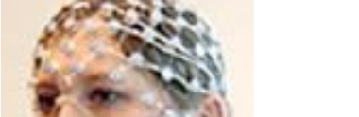
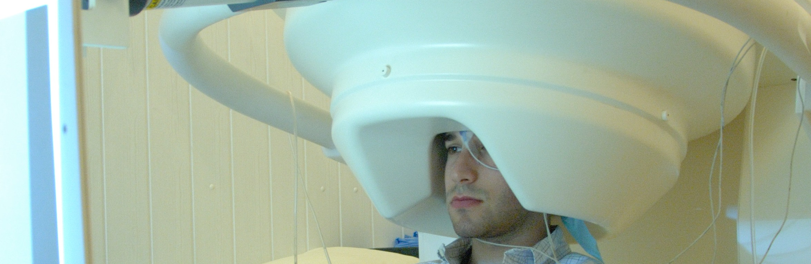
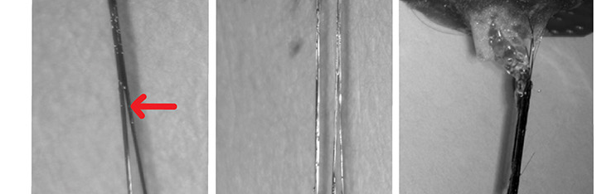
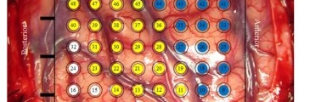
Electrical recording setups
EEG
MEG
Electrodes on the scalp
Helmet-shaped magnetic sensors
SINGLE-UNIT
ECoG
Fine probes sample spikes from selected neurons
An electrode grid rests on the cortical surface
METHOD
ANALYSIS
WARRANT
7

Slide 8
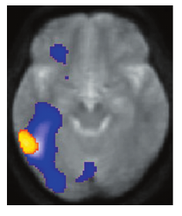
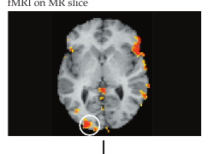
PET and fMRI detect physiology associated with neural activity
PET ACTIVATION IMAGING
BOLD fMRI
Radioactive tracer
Signal accumulates over about a minute
Practical localization around a centimeter in the assigned example
Endogenous MR contrast
Signal is related to blood oxygenation
Several-millimeter localization; response unfolds over seconds
METHOD
ANALYSIS
WARRANT
8

Slide 9
BOLD is a delayed neurovascular signal
1 NEURAL ACTIVITY
ILLUSTRATIVE HEMODYNAMIC RESPONSE
Population activity changes local metabolic demand.
relative MR signal
event
2 VASCULAR RESPONSE
Blood flow and oxygen delivery follow the neural event.
delayed rise
3 DEOXYHEMOGLOBIN
Its local concentration changes over the next few seconds.
0
5
10
15
20
4 MR SIGNAL
undershoot
time after event (s)
The measured BOLD signal rises and returns toward baseline.
Textbook example: onset ~1–2 s · peak ~5–6 s · return toward baseline ~12–15 s
METHOD
ANALYSIS
WARRANT
9

Slide 10
Design and contrast turn time series into interpretable results
BLOCK DESIGN
EVENT-RELATED DESIGN
A
B
A
A
B
A
B
A
A
REST
B
B
Sustained periods of different conditions
Responses estimated for individual event types
TASK CONTRAST
MODEL + THRESHOLD
Condition A
−
Condition B
=
specified comparison
thresholded statistical estimates
An activation map is not the scanner’s raw output. It is the result of a specified design, model, contrast, and threshold.
METHOD
ANALYSIS
WARRANT
10

Slide 11
Reverse inference adds a premise the map does not supply
OBSERVED RESULT
Region R responds differently in Condition A and Condition B.
Process P
Process Q
SUPPORTED CONCLUSION
Activity in Region R is associated with the condition difference.
REGION R
ADDITIONAL PREMISE
Region R responds selectively to Process P.
Process S
Process T
Without evidence of selectivity, Region R does not uniquely identify Process P.
METHOD
ANALYSIS
WARRANT
11

Slide 12
Damage and perturbation increase causal leverage
DOUBLE DISSOCIATION · ILLUSTRATIVE
PERTURBATION QUESTION
Change neural activity or signaling
↓
Measure behavior or another outcome
↓
Infer causal contribution—with limits
Selectivity · spread · compensation · task design · outcome measurement
METHOD
ANALYSIS
WARRANT
12

Slide 13
Representational analyses ask what patterns can discriminate
MVPA
REPETITION SUPPRESSION
Similar regional means; different voxel patterns
Under an adaptation model, does repetition reduce the response?
Condition A
Condition B
first A
repeat A
new B
Can a multivoxel pattern discriminate conditions in held-out data?
Prediction within a study does not guarantee interpretation—or accuracy for a new person.
METHOD
ANALYSIS
WARRANT
13

Slide 14
Connectivity measures dependence—not causal direction
Functional connectivity measures statistical dependence among signals.
A influences B
B influences A
A third process influences both
C
A
→
B
B
→
A
A
B
The same covariation can fit several causal structures.
Directional models compare specified hypotheses; conclusions depend on the model and design.
METHOD
ANALYSIS
WARRANT
14

Slide 15
The ethical question determines which outcomes matter
BEHAVIOR
FIRST-PERSON EVIDENCE
Choice, accuracy, reaction time
Surveys, interviews, qualitative analysis
PERSON
CLINICAL OUTCOMES
EVIDENCE SYNTHESIS
Symptoms, functioning, adverse events, follow-up
Systematic review across studies
NEURAL EVIDENCE
Recorded signals and perturbation effects
What did the person do? Did an intervention help or harm? How did participants understand the experience? How consistent is the literature?
METHOD
ANALYSIS
WARRANT
15

Slide 16
Designing a moral-judgment study
People often judge switching a trolley differently from pushing a person, even when both actions could save five people at the cost of one life.
SWITCH
FOOTBRIDGE
trolley
trolley
METHOD
ANALYSIS
WARRANT
What behavioral or neural signals would you record?
What conditions would you compare? What baseline would make the comparison meaningful?
What could a difference between conditions support? What would remain unresolved?
Pairs: choose measures · specify a comparison and baseline · state one warranted conclusion and one limit
METHOD
ANALYSIS
WARRANT
16

Slide 17
NEXT: THE FIELD AND THE ETHICAL TOOLKIT
What combination of evidence
would justify the claim?
RECORD
PERTURB
BEHAVIOR + EXPERIENCE
NORMATIVE PREMISES
covariation
causal contribution
consequences for persons
ethical conclusion
Convergence is strongest when methods have different limitations—and every conclusion still depends on design, analysis, and assumptions.
METHOD
ANALYSIS
WARRANT
17

