Slide 1
PHL / NEU 251 · SESSION 3
Neural currency

Slide 2
A neural signal changes form as it travels
ELECTRICAL
CHEMICAL
MODULATORY
Inside the neuron
Changes in voltage integrate inputs and trigger action potentials.
At the synapse
Neurotransmitters cross the cleft and bind to receptors.
Across a circuit
Diffuse signals shift how strongly circuits respond.
These forms work together. None of them, on its own, is a thought or feeling.
2

Slide 3
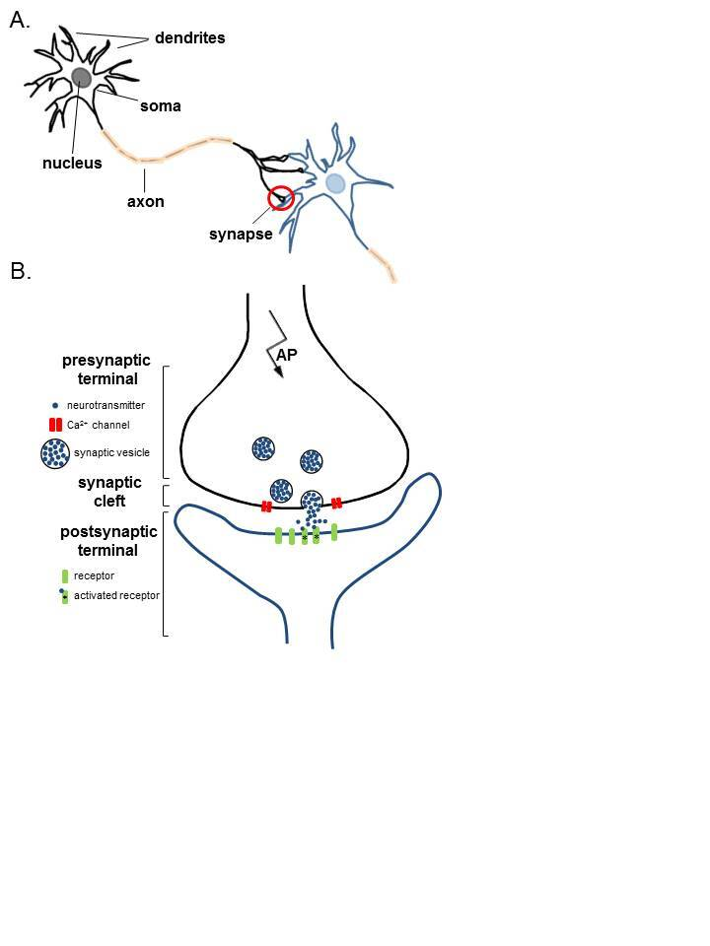
The textbook neuron is useful, but it leaves a lot out
Use the diagram to track three jobs
Receive and integrate: dendrites + soma
Send: axon + action potential
Influence the next cell: terminals + synapse
3

Slide 4
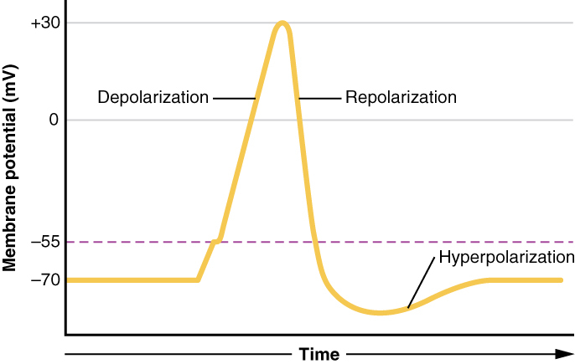
An action potential moves down the axon
Threshold → spike → reset
Inputs push membrane voltage toward or away from threshold.
Na⁺ rushes in during depolarization; K⁺ flows out during recovery.
The refractory period limits how soon the neuron can fire again.
4

Slide 5
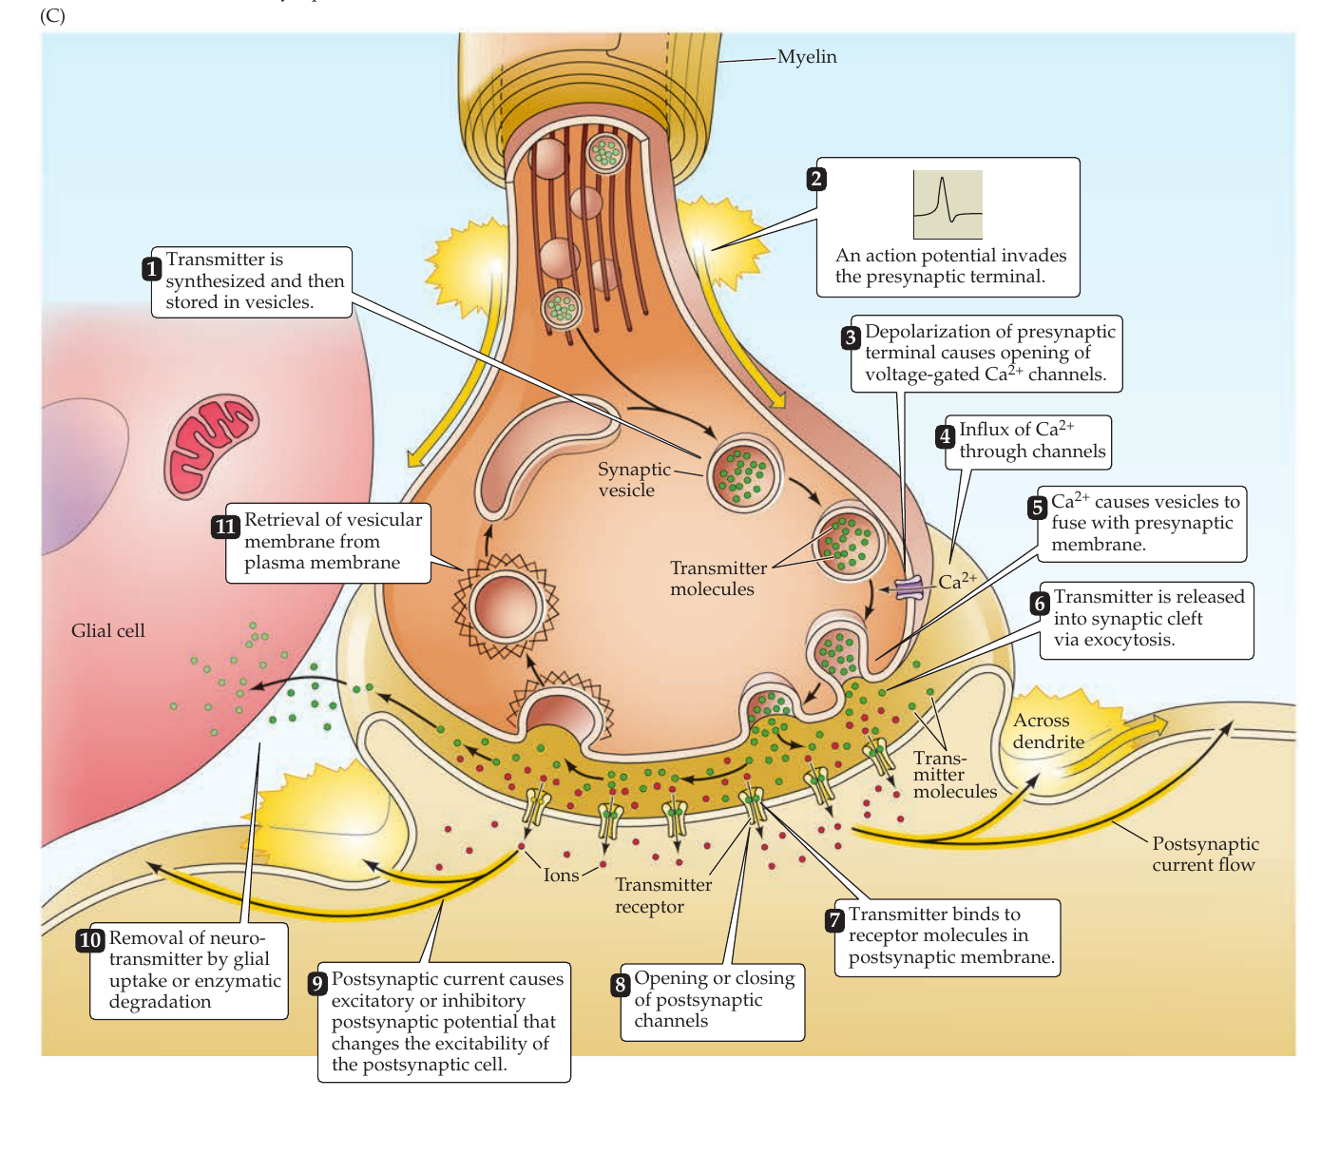
At the synapse, an electrical signal becomes chemical and then electrical again
Four steps
1 The action potential opens Ca²⁺ channels.
2 Ca²⁺ triggers vesicle fusion and transmitter release.
3 Receptors change the postsynaptic cell.
4 Transporters or enzymes clear the transmitter.
5

Slide 6
Neurotransmitter can have multiple effects
Its effect depends on the molecule, receptor, target cell, and context.
Molecule
Which chemical reaches the target?
Receptor
Which subtype binds it, and how does that receptor signal?
Target cell
Which channels and signaling machinery are present?
Context
When does it arrive, and what else is the network doing?
6

Slide 7
Biogenic amines usually adjust the brain's operating state
Five examples: dopamine, norepinephrine, epinephrine, histamine, and serotonin.
Dopamine
Movement, learning, and motivation
Norepinephrine + epinephrine
Arousal, attention, and autonomic state
Histamine
Wakefulness, attention, and vestibular function
Serotonin
Sleep and wakefulness, affect, and many other processes
7

Slide 8
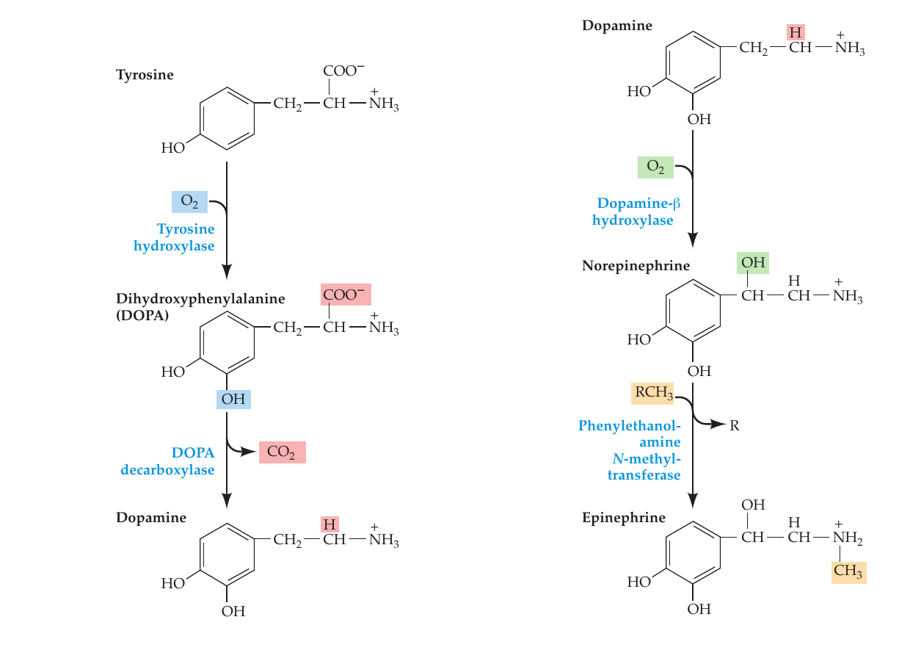
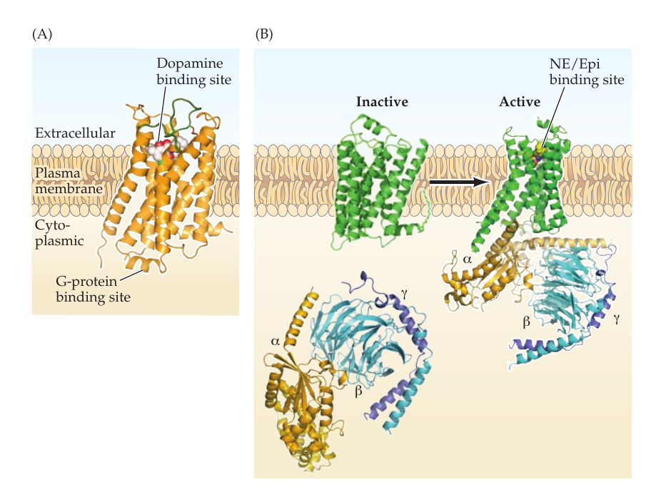
The same synthetic pathway can lead to very different effects
SAME SYNTHETIC PATHWAY
RECEPTORS CHANGE THE STORY
Tyrosine → DOPA → dopamine → norepinephrine → epinephrine
Binding is the first step; receptor subtype determines what happens inside the cell.
8

Slide 9
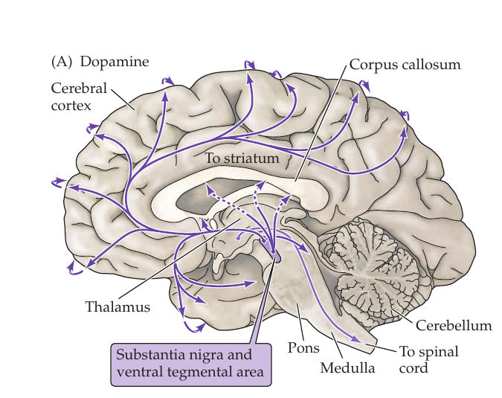
Dopamine does several jobs in several circuits
One transmitter, several systems
Movement: substantia nigra → striatum
Learning and motivation: midbrain → striatal and cortical targets
DAT limits dopamine exposure.
Cocaine blocks DAT. Amphetamine enters through DAT/NET, disrupts vesicular storage, and reverses transport.
9

Slide 10
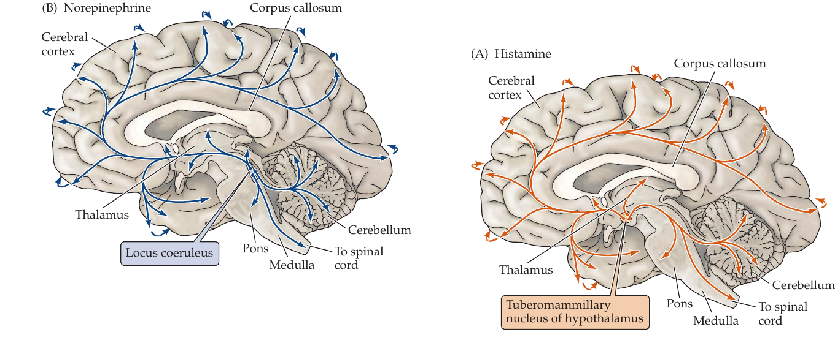
Norepinephrine and histamine help set the brain's state
Small nuclei, wide reach
Norepinephrine: locus coeruleus → arousal, attention, sleep and wakefulness, feeding
Histamine: tuberomammillary nucleus → arousal, attention, vestibular function
Older antihistamines can cause drowsiness because they cross the blood-brain barrier and block central H₁ receptors.
10

Slide 11
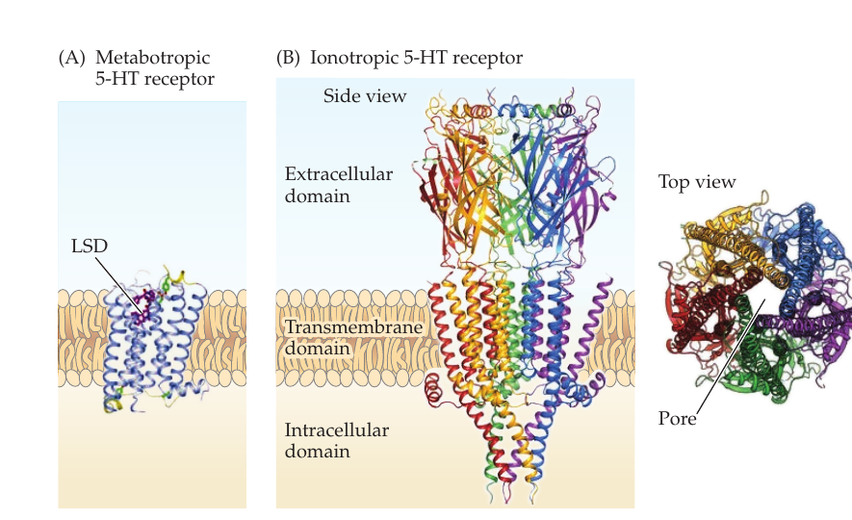
Serotonin's effects vary by receptor and pathway
The 5-HT system includes many kinds of receptors
Raphe nuclei project widely.
Most 5-HT receptors are metabotropic. 5-HT₃ is ionotropic.
SERT clears serotonin; SSRIs inhibit SERT.
LSD acts at several metabotropic 5-HT receptors.
11

Slide 12
Drugs can intervene at several points in the mechanism
MAKE + LOAD
RELEASE + CLEAR
RECEIVE + DEGRADE
Build the signal
Precursors, enzymes, and VMAT determine what reaches vesicles.
Change exposure
Cocaine, amphetamine, and SSRIs alter release or clearance.
Change the response
Agonists, antagonists, and MAO or COMT inhibitors act at later steps.
A target identifies the intervention point. The psychological effect still needs explanation.
12

Slide 13
What should count as a functional unit?
Neuron doctrine
Neurons are discrete cells, but the doctrine is incomplete.
Dendrite
A dendritic branch can perform nonlinear computations within one neuron.
Synapse + glia
The relevant sender and receiver may extend beyond whole neurons.
Population
Some cognitive variables appear in patterns across many neurons.
13

Slide 14
Molecular facts do not settle psychological or ethical questions
MECHANISM
PSYCHOLOGY
ETHICS
What changed?
Transmitter, receptor, cell, circuit, and time course.
Which capacity?
Performance in a task, situation, and social context.
What follows?
Treatment, control, responsibility, risk, or justice.
Biology constrains the argument. It does not supply the missing psychological or ethical premises.
14

Slide 15
Can you trace the signal and defend the inference?
1 | SIGNAL
What carries a signal within a neuron? What carries it across a synapse?
2 | RELEASE
Why does Ca²⁺ matter at the presynaptic terminal?
3 | RECEPTOR
Why can the same transmitter produce different effects?
4 | CLEARANCE
Which transporters clear dopamine and serotonin?
5 | INFERENCE
An SSRI changes mood. What does that show about serotonin, and what remains open?
15

Slide 16
NEXT: THE INSTRUMENTS · MEASURING MINDS
A molecule is one part of a much larger mechanism.
To explain behavior, follow the signal through receptors, cells, circuits, tasks, and contexts.

