Slide 1
PHL / NEU 251 · SESSION 2
Brain geography

Slide 2
A brain map gives coordinates
What a map gives us
Shared names for position, boundaries, and pathways—enough to make studies comparable.
What it cannot give us
Why a person acted, what they experienced, or what they could have done otherwise.
2

Slide 3
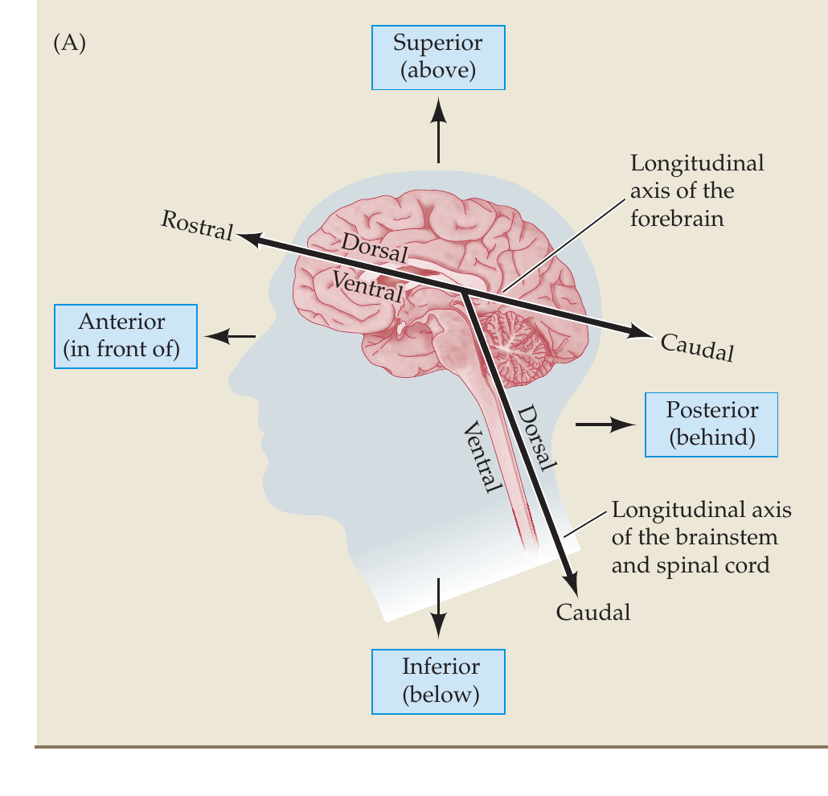
Relational geography
Brain directions are relational
The human neuraxis bends about 120° as the forebrain turns above the brainstem. Rostral and caudal follow its long axis; dorsal and ventral change orientation at the bend. Superior and inferior mean above and below.
3

Slide 4
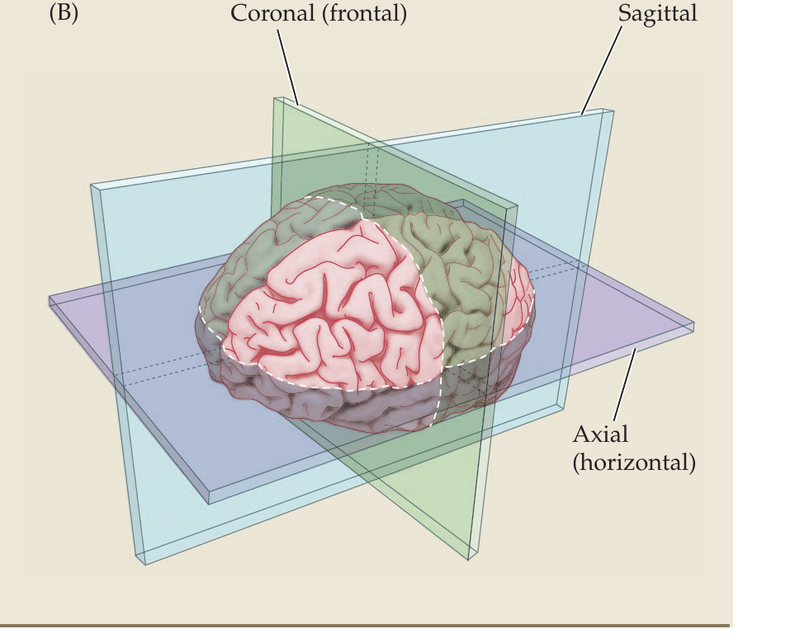
Three cuts produce three different brain maps
Ask what plane you are seeing
Sagittal: left / right
Coronal (frontal): front / back
Axial: top / bottom
4

Slide 5
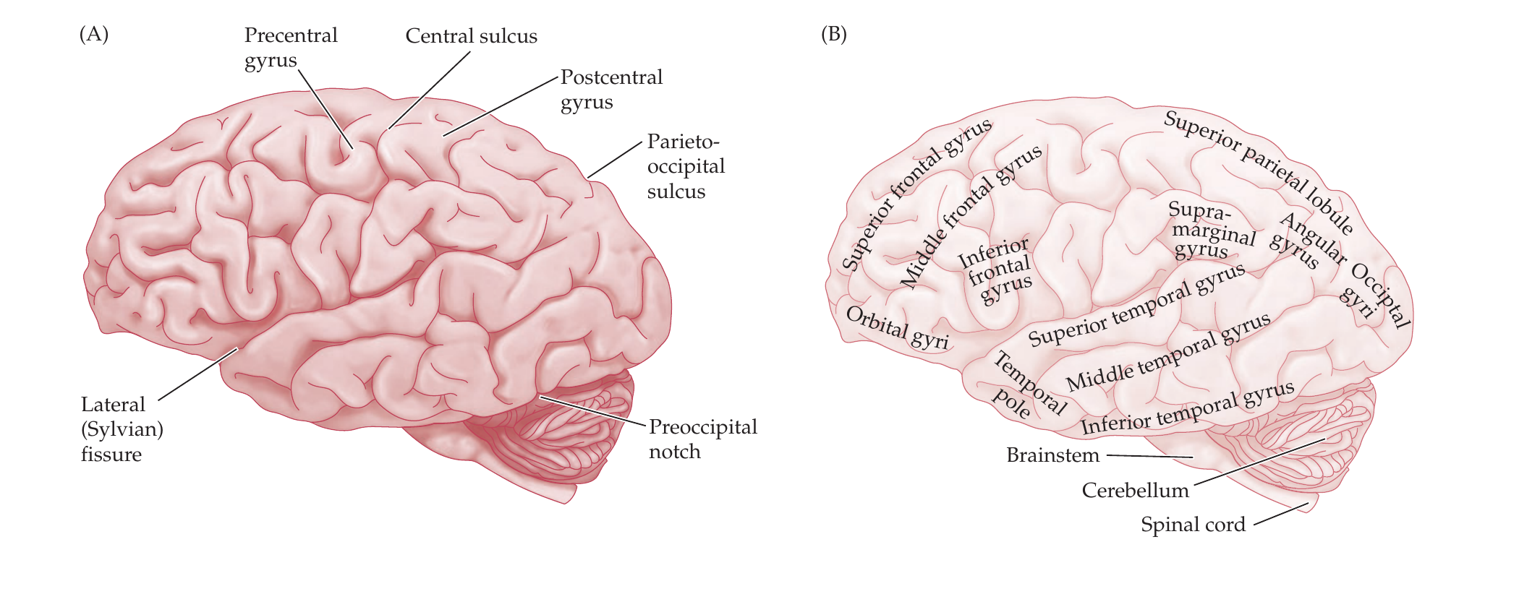
Three landmarks organize the folded cortical sheet
Surface landmarks
The cortex is a roughly 2 mm sheet of gray matter.
Gyri are ridges; sulci are grooves; especially deep sulci are fissures.
The central sulcus separates frontal and parietal cortex; pre- and postcentral gyri sit on either side.
The lateral fissure marks the temporal boundary.
5

Slide 6
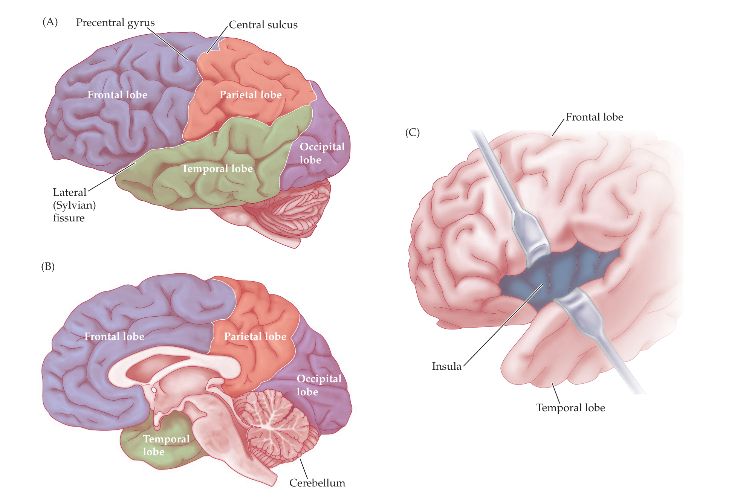
The lobes are not functional modules
Coarse landmarks
Occipital: vision
Parietal: touch + spatial processing
Temporal: audition + recognition
Frontal: action + control
Insula: body state + salience
6

Slide 7
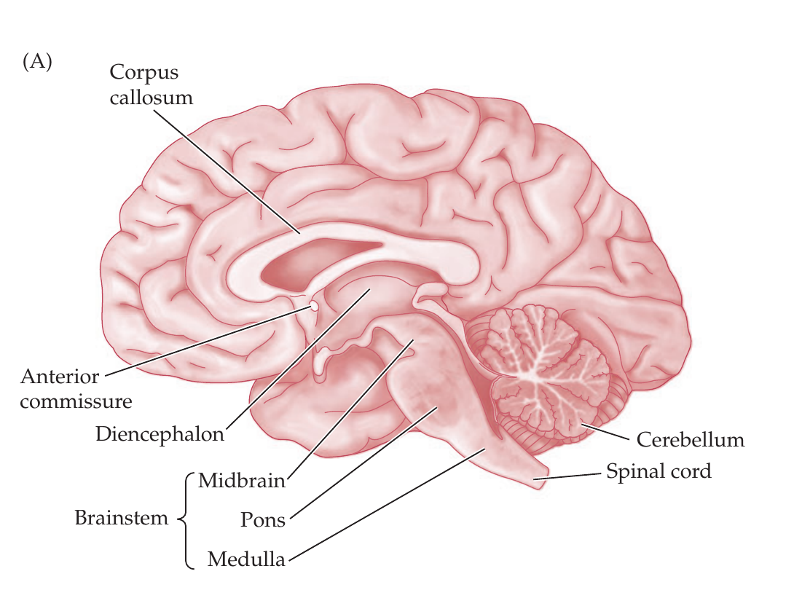
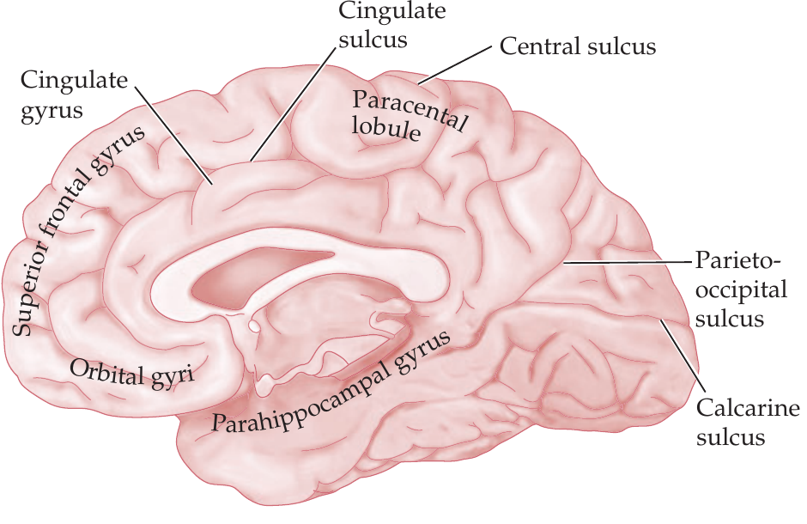
The medial view reveals cortex and diencephalon
DEEP MIDLINE
Diencephalon = thalamus + hypothalamus.
MEDIAL CORTEX
Cingulate and parahippocampal cortex wrap the midline.
7

Slide 8
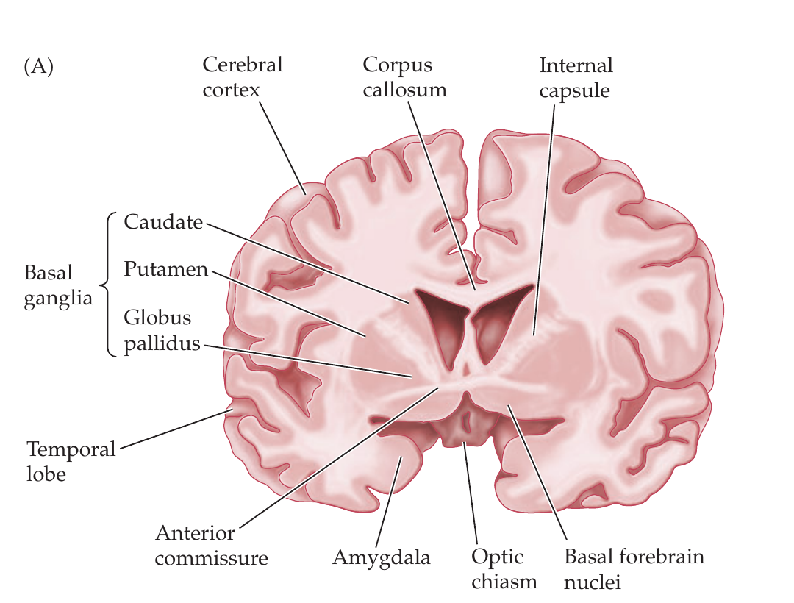
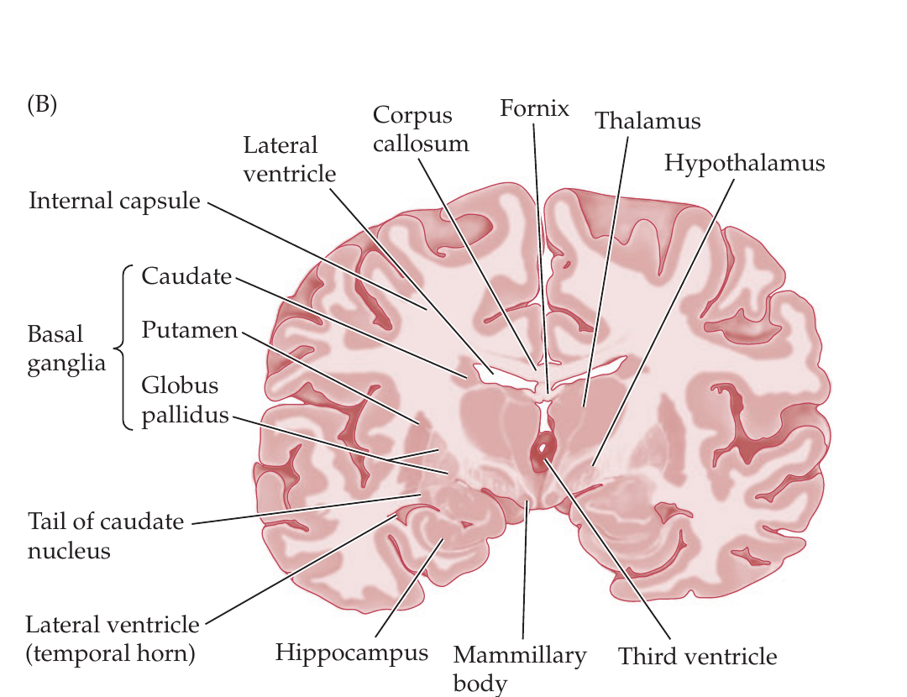
Deep structures sit inside the cortical shell
ANTERIOR SECTION
POSTERIOR SECTION
Basal ganglia · internal capsule · amygdala
Thalamus · hypothalamus · hippocampus (folded cortex) · fornix · ventricles
8

Slide 9
White matter turns regions into a system
Gray matter: cell bodies and local processing. White matter: myelinated axons connecting regions.
Corpus callosum
Links the cerebral hemispheres.
Internal capsule
Main route between cortex and brainstem / spinal cord.
Fornix
Connects hippocampus with hypothalamic regions.
Cerebral peduncles
Carry ascending and descending fibers through midbrain.
9

Slide 10
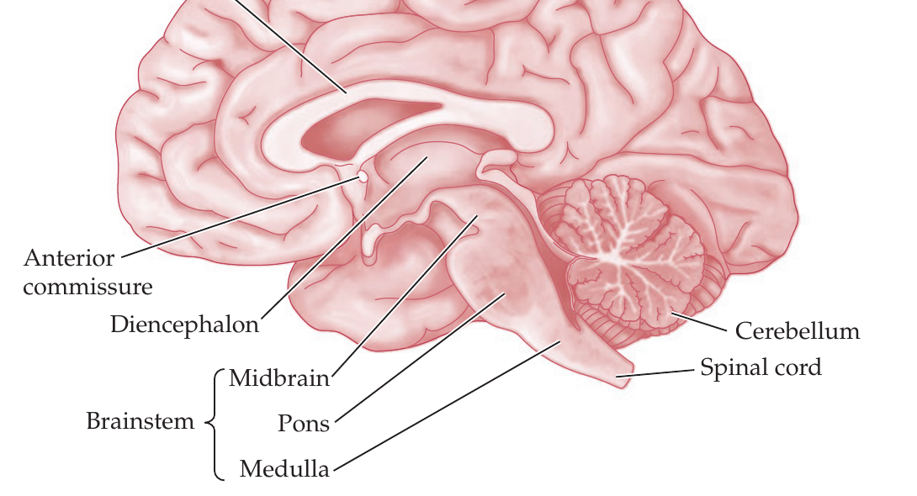
Brainstem and cerebellum do different jobs
Two neighboring structures
Brainstem: midbrain → pons → medulla. Routes ascending and descending signals; supports arousal, breathing, cardiovascular control, and cranial-nerve functions.
Cerebellum: coordinates movement, posture, balance, and timing; also implicated in cognition and affect.
10

Slide 11
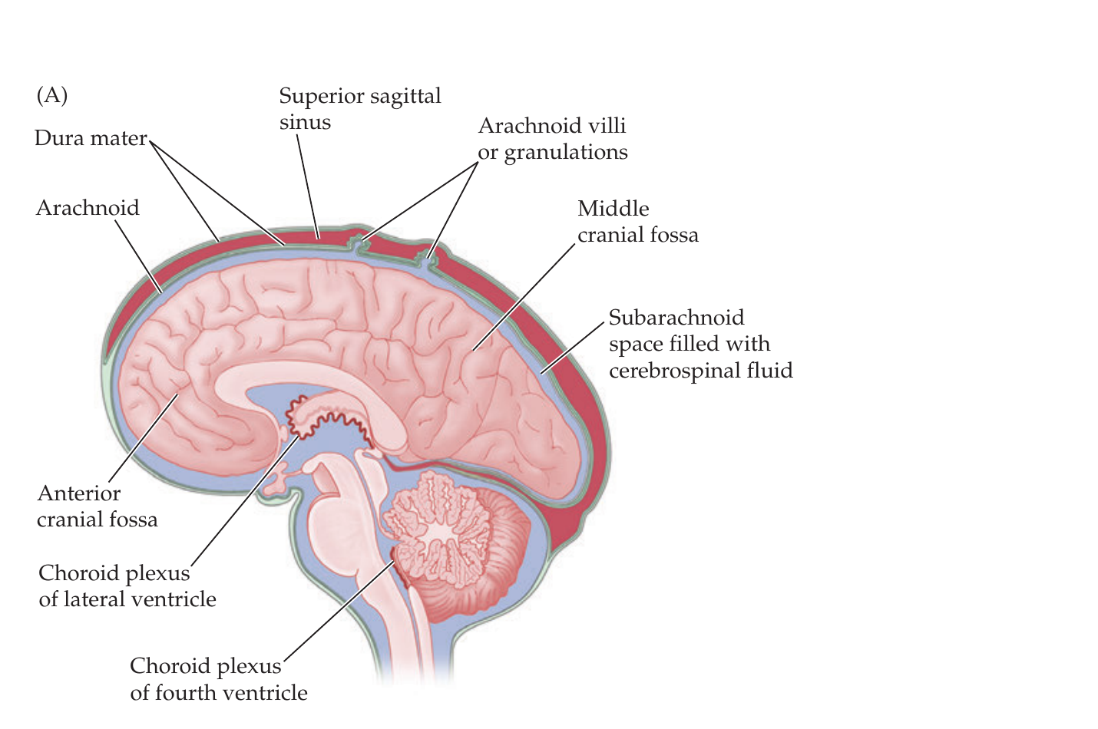
Ventricles are fluid spaces—and useful landmarks
CSF circulation
Choroid plexus makes CSF → lateral ventricles → interventricular foramen → third ventricle → cerebral aqueduct → fourth ventricle → subarachnoid space → arachnoid villi → venous blood.
11

Slide 12
Three kinds of evidence, three kinds of doubt
LESION
STIMULATE
IMAGE
What fails after damage?
Network disruption complicates causal inference.
What changes when perturbed?
Spread and compensation complicate causal inference.
What covaries during a task?
.
Different methods constrain different inferences.
12

Slide 13
Can you navigate—and reason from—this brain?
1 | ANTERIOR
Which appears in the anterior section: amygdala or hippocampus?
2 | PLANE
Which plane divides the brain into front and back halves?
3 | SURFACE
What separates primary motor from primary somatosensory cortex?
4 | CONNECTION
Which tract is the main bridge between hemispheres?
5 | INFERENCE
Amygdala activity rises during moral dilemmas. What does that establish?
13

Slide 14
NEXT: NEURONS + NEUROMODULATORS
What drives the engine?

